Slide 1
Application Delivery Fundamentals 2.0 B: Java
GWT
Parameswari Ettiappan

Slide 2
Goals
Introduction to GWT
GWT Features
GWT Compiler
GWT Architecture
GWT Components
GWT Lifecycle
Panels
Layouts
Widgets

Slide 3
Software Requirements
Minimum java 8
Eclipse 2019 JEE
maven 3.6
GWT 2.9

Slide 4
Introduction to GWT
In May 2006, Google released the Google Web Toolkit (GWT), a set of development tools, programming utilities, and widgets that let you create rich Internet applications differently than earlier.
The difference between GWT and all those other frameworks is that with GWT you write your browser-side code in Java instead of JavaScript.
For those of us who rely on Java as a trusted tool, this is a monumental difference over traditional JavaScript coding.

Slide 5
Introduction to GWT
The need to write code in Java instead of JavaScript is rooted in the everincreasing size and complexity of rich Internet applications.
Large applications are difficult to manage, and Java was designed to make large application development manageable.
While bringing all of Java’s benefits to rich Internet applications, GWT still allows you to interact with existing JavaScript code.
When you embrace GWT, it doesn’t mean that you need to throw away all your old JavaScript code: GWT makes every attempt to be flexible with regard to integration, allowing it to integrate not only with existing JavaScript code, but also with your existing server-side services.

Slide 6
Introduction to GWT
At the core of GWT is a Java-to-JavaScript compiler that produces code capable of running on Internet Explorer, Firefox, Mozilla, Safari, and Opera.
The compiler converts the Java syntax to JavaScript, utilizing JavaScript versions of commonly used Java classes like Vector, HashMap, and Date.
The compiler can then weave in JavaScript that you’ve referenced in your code, allowing you to utilize popular libraries like Scriptaculous, JSCalendar, and TinyMCE.

Slide 7
Introduction to GWT
Beyond the compiler, GWT also includes a large library of widgets and panels, making it effortless to build a web application that looks more like a desktop application.
The widget library includes the usual suspects like text boxes, dropdown menus, and other form fields.
In addition, it includes complex widgets including a menu bar, tree control, dialog box, tab panel, stack panel, and others.
When it comes to communication with the server, GWT has a tool for every job.

Slide 8
GWT comprehensive set of tools

Slide 9
GWT's Java-to-JavaScript compiler
The GWT compiler’s responsibility is to convert your Java code into JavaScript code, in much the same way the Java compiler compiles your Java code into bytecode.
You compile your project by running the Java program com.google.gwt.dev.GWTCompiler, passing it the location of your module definition file along with some other parameters.
A module is a set of related Java classes and files accompanied by a single configuration file.
The module definition typically includes an entry point, which is a class that executes when the application starts.

Slide 10
GWT's Java-to-JavaScript compiler
The compiler starts with the entry-point class, following dependencies required to compile the Java code.
The GWT compiler works differently than the standard Java compiler because it doesn’t compile everything in the module; it includes only what is being used.
This is useful in that it lets you develop a large library of supporting components and tools, and the compiler includes only those classes and methods used by the entry-point class.

Slide 11
GWT's Java-to-JavaScript compiler
The compiler has three style modes that determine what the resulting Java- Script looks like.
The default style is obfuscate, which makes the JavaScript look like alphabet soup.
Everything is compressed and nearly impossible to decipher.
This isn’t done to prevent it from being read, although that could be seen as a benefit for preventing code theft; instead, it helps keep the resulting JavaScript file as small as possible.
This is a real concern as your application gets larger.
This snippet of JavaScript code is the output of the GWT compiler using the obfuscated compiling mode.
function b(){return this.c + '@' + this.d();}

Slide 12
GWT's Java-to-JavaScript compiler
The next style is pretty, which generates readable JavaScript. This compiled code snippet is derived from the same original Java source code as the obfuscated sample.
You can now see that the code is a toString() method, a common method for Java classes, but you still can’t tell what class this code is for:
function _toString(){
return this._typeName + '@' + this._hashCode();
}

Slide 13
GWT's Java-to-JavaScript compiler
The last style is detailed, which produces JavaScript code that looks like the pretty style with the addition of the full class name as part of the JavaScript method name.
This makes it easy to trace the JavaScript code back to the originating Java code.
In this code sample, compiled in detailed mode, you can easily see that this is the toString() method for java.lang.
Object, the root of all Java classes.
function java_lang_Object_toString__(){
return this.java_lang_Object_typeName + '@' + this.hashCode__();
}

Slide 14
GWT's Java-to-JavaScript compiler
The pretty and detailed styles are typically used only during development so that JavaScript errors in your browser are easier to track back to the source Java code.
For production, using obfuscated is favorable because it keeps the Java- Script file size down and can help to hide trade secrets.
Another important aspect of the compiler is that it compiles from Java source code, not compiled Java binaries.
This means the source for all the Java classes you’re using must be available.
This plays a role when you want to distribute GWT code for reuse.
When you build distributable Java Archive (JAR) files, you must include both the Java source and compiled Java class files.

Slide 15
GWT's Java-to-JavaScript compiler
One last feature to note is that when your code is compiled to JavaScript, it results in a different JavaScript file for each browser type and target locale.
The supported browsers include Internet Explorer, Firefox, Mozilla, Opera, and Safari.
Typically, this means your application will be compiled to a minimum of four or five separate JavaScript files.
Each of these files is meant to run on a specific browser type, version, and locale. A bootstrap script, initially loaded by the browser, automatically pulls the correct file when the application is loaded.
The benefit of this process is that the code loaded by the browser doesn’t contain code it can’t use.
Typically, this doesn’t result in huge bandwidth savings; but in some cases, especially when you’re providing the interface in multiple locale settings, the size can be reduced significantly.

Slide 16
Accessing the JRE emulation library

Slide 17
Accessing the JRE emulation library

Slide 18
Understanding GWT's widget and panel library
GWT ships with a large set of widgets and panels.
The distinction between widgets and panels is that a widget is some sort of control used by a user, and a panel is a container into which controls can be placed.
For example, a button or text box is a widget, and a table that displays the button and text box left-to-right on the page is a panel.
But panels in GWT aren’t just for layout; some panels offer interactivity.
Generally speaking, GWT uses three types of components: widgets, panels for layout, and interactive panels

Slide 19
Understanding GWT's widget and panel library

Slide 20
Understanding GWT's widget and panel library
The MenuBar, a widget, is shown across the top of the page. The TabPanel, an interactive panel, appears in the middle of the page, acting as a container for a TextArea and Button widget.
The MenuBar and TabPanel are then contained in an AbsolutePanel that allows for exact positioning of the components it contains.

Slide 21
Examining GWT’s internationalization and configuration tools
GWT provides several techniques that can aid you with internationalization and configuration issues.
This may seem like an odd pair, but they’re similar in that you want the ability to store text strings or numeric values in a properties file and to access them from your application.
GWT provides two primary mechanisms that should handle most needs: static inclusion at compile time, and dynamic inclusion at runtime.
The static method is accomplished by implementing the Constants or Messages interface, whereas the dynamic method uses the GWT Dictionary class.

Slide 22
Examining GWT’s internationalization and configuration tools
For example, perhaps you want to use a properties file to store a welcome message along with the image path of your application’s logo.
You provide a method for each in your interface:
public interface MySettings extends Constants
{
String welcomeMessage();
String logoImage();
}
Once you have your interface, you can use GWT to dynamically create an instance of this interface, and it automatically attaches the properties file settings to it.

Slide 23
Examining GWT’s internationalization and configuration tools
The Messages interface differs from Constants in that you may specify argumentsto the methods, which are then used to fill placeholders in the propertytext.
For example, you may want to alter the previous interface to allow the person’s name to be included in the greeting message.
Your properties file might look like the following:
welcomeMessage = Welcome to my book {0} {1}
logoImage = /images/logo.jpg
The placeholder {0} is used to mark the place where the first variable should be inserted into the message and {1} for the second. The interface you use for Constants needs to be modified to use the Messages interface instead, and you add two arguments to your method:

Slide 24
Examining GWT’s internationalization and configuration tools
public interface MySettings extends Messages
{
String welcomeMessage(String fname, String lname);
String logoImage();
}

Slide 25
Examining GWT’s internationalization and configuration tools
On the flip side of the coin, there are occasions where the property values are generated dynamically—for example, the details of a specific user.
In this case, you need a dynamic runtime mechanism to look up property information.
For this purpose, GWT provides a Dictionary class, which doesn’t use properties files.
Instead, you can use the Dictionary object to grab settings that have been embedded in the HTML as JavaScript objects:
var MySettings = {
welcomeMessage: "Welcome to my book",
logoImage: "/images/logo.jpg"
};

Slide 26
Examining GWT’s internationalization and configuration tools
In the GWT application, you load the JavaScript object into a Dictionary instanceby using the static method Dictionary.getDictionary(), passing the JavaScript variable name as an argument.
You can then use the methods of the returned Dictionary object to get the individual settings.
This mechanism is ideal when you want to pass data to your GWT application:
Dictionary settings = Dictionary.getDictionary("MySettings");
String logo = settings.get("logoImage");

Slide 27
Calling remote procedures with GWT
Most nontrivial GWT applications need the ability to communicate information between the browser client and the server.
For instance, perhaps the application needs to fetch data to display to the user, or to log the user into the application, or to load an external data file.
Fortunately, today’s browsers include a special Java- Script object called XMLHttpRequest that allows communication between the browser and server without forcing a page refresh like traditional HTML forms do.
This special JavaScript object is the basis for making browser-based Remote Procedure Calls (RPCs).

Slide 28
Calling remote procedures with GWT
GWT provides two tools that sit on top of the XMLHttpRequest object.
The first is the RequestBuilder class, which is essentially a wrapper around this object, although it’s a bit more Java-like in its usage.
The second tool, GWT-RPC, is more elaborate and lets you send and receive real Java objects between the client and server.

Slide 29
Making RPC requests with RequestBuilder
The Request Builder class lets you create a request to be submitted to the server, gives you the ability to fire off the request, and provides access to the results sent back from the server. String url = "/service/search";
RequestBuilder rb = new RequestBuilder(RequestBuilder.GET, url);
try {
Request request = rb.sendRequest("term=GWT+in+Action",
new RequestCallback() {
public void onResponseReceived (Request req, Response res)

Slide 30
Making RPC requests with RequestBuilder
// process here
}
public void onError (Request req, Throwable exception) {
// handle error here
}
});
}
catch (RequestException e) {
// handle exception here
}

Slide 31
Communicating with GWT-RPC
The GWT-RPC mechanism lets you send Java objects between the client and server with only a little additional work on both the client and server sides.

Slide 32
Investigating GWT’s XML parser
GWT takes advantage of the fact that modern browsers have the ability to parse XML and create a DOM tree.
Because the parsing is done by the browser and not by GWT, you get the performance benefit of native code execution.
This code sample shows you how the XMLParser is used to create a Document object, through which the entire DOM tree can be traversed:

Slide 33
Investigating GWT’s XML parser

Slide 34
Managing the browser history
One of the valid complaints about rich Internet applications is that they break the browser’s Back button.
What we mean is that if you replace a piece of content on the web page dynamically with JavaScript, the browser doesn’t count that as a page change.
Often, the user sees the content of the page change, so they assume they can click the Back button in the browser to get back to the previous content; but their assumption is false.
This behavior is due to the fact that changing the content of a page programmatically is fairly new to many users, and they don’t understand it.
To provide a solid user experience, we need to write the application so that the back button behaves in a manner that the user expects

Slide 35
Managing the browser history
The popular solution to this problem tends to be a little complicated to implement and use. It requires adding a hidden frame to your page and doing some amount of scripting to get it to work.
In the case of GWT, all the hard work has been done for you.
To access it, you need to write an event handler that implements the HistoryListener interface and register it with the History object.
Here you register an instance of a user defined class MyHistoryListener:
History.addHistoryListener(new MyHistoryListener());
With the listener registered, you can emulate a page change by creating a new history token.

Slide 36
Managing the browser history
For example, you might create a token overview for the page with information about your company and a token reports for a different page showing reporting information.
Note that when we say page, we don’t mean that the browser is loading a different URL.
This is GWT, after all, so a page can be content loaded by selecting a tab on a TabPanel or selecting an option from a MenuBar:
History.newItem("overview");
History.newItem("reports");

Slide 37
Managing the browser history
Creating a new token does two things. First, it invisibly loads a hidden frame on the web page with a new page.
Because the hidden frame is loaded with a different page, the browser counts this as a new page view and adds it to the browser history.
Second, it calls the onHistoryChanged() method of the HistoryListener to indicate a content change:

Slide 38
Managing the browser history

Slide 39
Introducing GWT’s JUnit integration
To create a new test case, you create a class that extends GWTTestCase, which in turn extends JUnit’s own TestCase class.
You then need to implement just one required method, getModuleName(), followed by any number of specific tests.
GWT uses the module name to locate the project configuration file.
public class MathTest extends GWTTestCase
{
public String getModuleName ()
{
return "org.mycompany.MyApplication";
}

Slide 40
Introducing GWT’s JUnit integration
public void testAbsoluteValue ()
{
int absVal = Math.abs(-5);
assertEquals(5, absVal);
}
}

Slide 41
JSNI
GWT JSNI is used to solve problems such as, when we need to integrate GWT with existing handwritten JavaScript or with a third-party JavaScript library.
Occasionally, we need to access low-level browser functionality which is not exposed by the GWT class API’s.
JSNI is web equivalent of inline assembly code and can use in many ways such as:
Implement a Java method directly in JavaScript.
Wrap type-safe Java method signatures around existing JavaScript.
Call from JavaScript code into Java code and vice-versa.
Throw exceptions across Java/JavaScript boundaries.
Read and write Java fields from JavaScript.
Use development mode to debug both Java source (with a Java debugger) and JavaScript (with a script debugger).

Slide 42
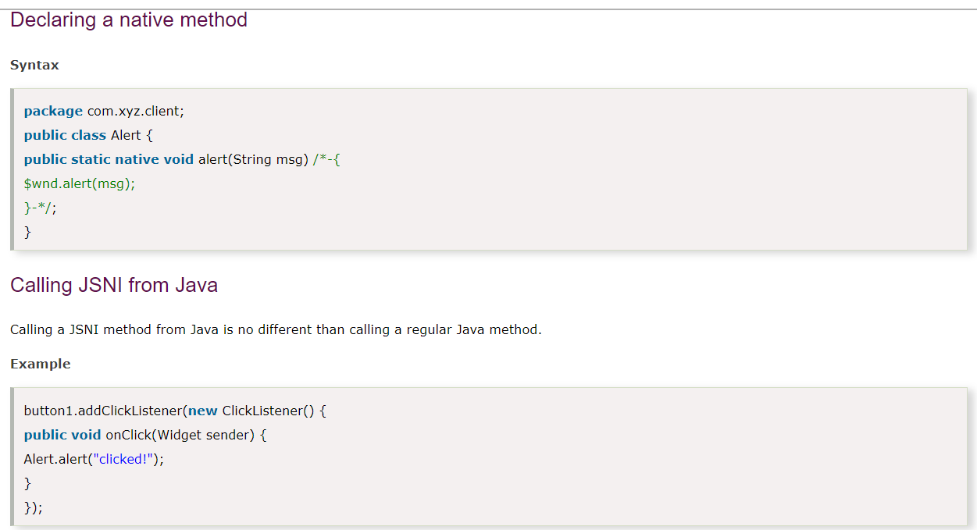
JSNI

Slide 43
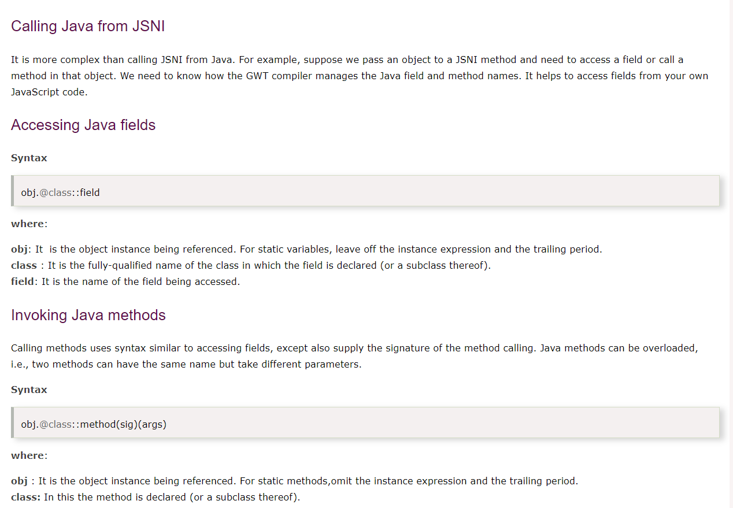
JSNI

Slide 44
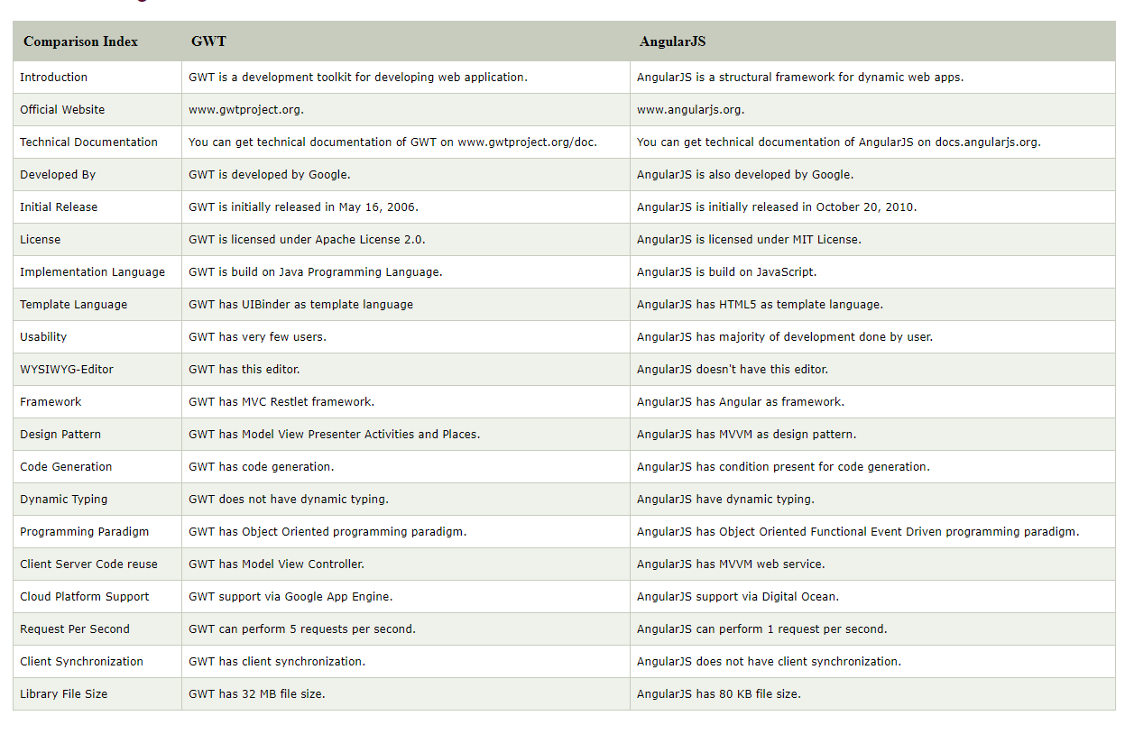
GWT vs Angular

Slide 45
GWT vs. other solutions

Slide 46
Swing

Slide 47
The GWT application development lifecycle

Slide 48
The GWT application development lifecycle

Slide 49
GWT Modes
GWT provides two modes:
Development Mode: allows to debug the Java code of the application directly via the standard Java debugger.
Web mode: the application is translated into HTML and Javascript code and can be deployed to a webserver.

Slide 50
What is a GWT Module?
A GWT module is simply an encapsulation of functionality. It shares some similarities with a Java package but is not the same thing.
A GWT module is named similarly to a Java package in that it follows the usual dotted-path naming convention.
For example, most of the standard GWT modules are located underneath “com.google.gwt”
However, the similarity between GWT modules and Java packages ends with this naming convention.
A module is defined by an XML descriptor file ending with the extension “.gwt.xml”, and the name of that file determines the name of the module.
For example, if we have a file named src/com/mycompany/apps/MyApplication.gwt.xml, then that will create a GWT module named com.mycompany.apps.MyApplication.
The contents of the .gwt.xml file specify the precise list of Java classes and other resources that are included in the GWT module.

Slide 51
Building your first GWT application

Slide 52
GWT RPC
RPC (Remote Procedure Call) helps in client communication with server. RPC is a process of calling a method from a class however, in this process only difference is that the class is located on a server but not actually the part of client program.
There is a problem with RPC, as JavaScript runs in web browser and the RPC call from browser it hangs browser until the response is received.
To avoid the browser hanging, GWT RPC call is made "Asynchronous" and the browser does not hang while waiting for the response.

Slide 53
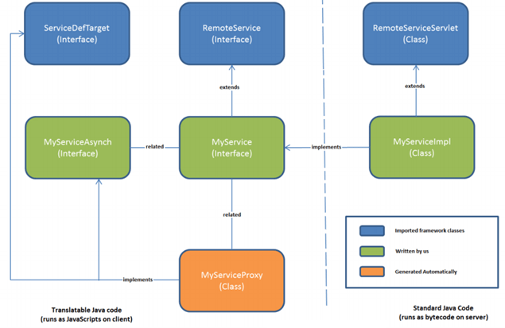
GWT RPC

Slide 54
GWT Panel
In GWT web application, panels are used to design user interface of the application. To layout their child widget GWT Panel uses HTML elements such as DIV, TABLE etc. It is used to define the layout of the user interface in the browser.
Basic Panels are enlisted below:
Root Panel: It is the top most panel where all other widgets are attached to it.
Flow Panel: It is the simplest panel which provides basic HTML layout.
HTML Panel: It is enclosed with specified HTML contents.
Form Panel: It specifies that any widget declared in this would be wrapped in HTML form element.
Scroll Panel: It puts all the content in scrollable area.
Grid: It helps to create HTML table.
Flex Table: It extends HTML table like GWT GRID but can be use to create table on demand.

Slide 55
GWT RootPanel
GWT RootPanel is the starting or the top most panel to which all other Widgets are attached.
To access the root panel in the application, we can use this syntax: RootPanel.get().
This panel consists of html pages.
Root panel returns the singleton value that binds the GWT application.
For control modification in web-app we can change the syntax as follows: RootPanel.get(String argument).

Slide 56
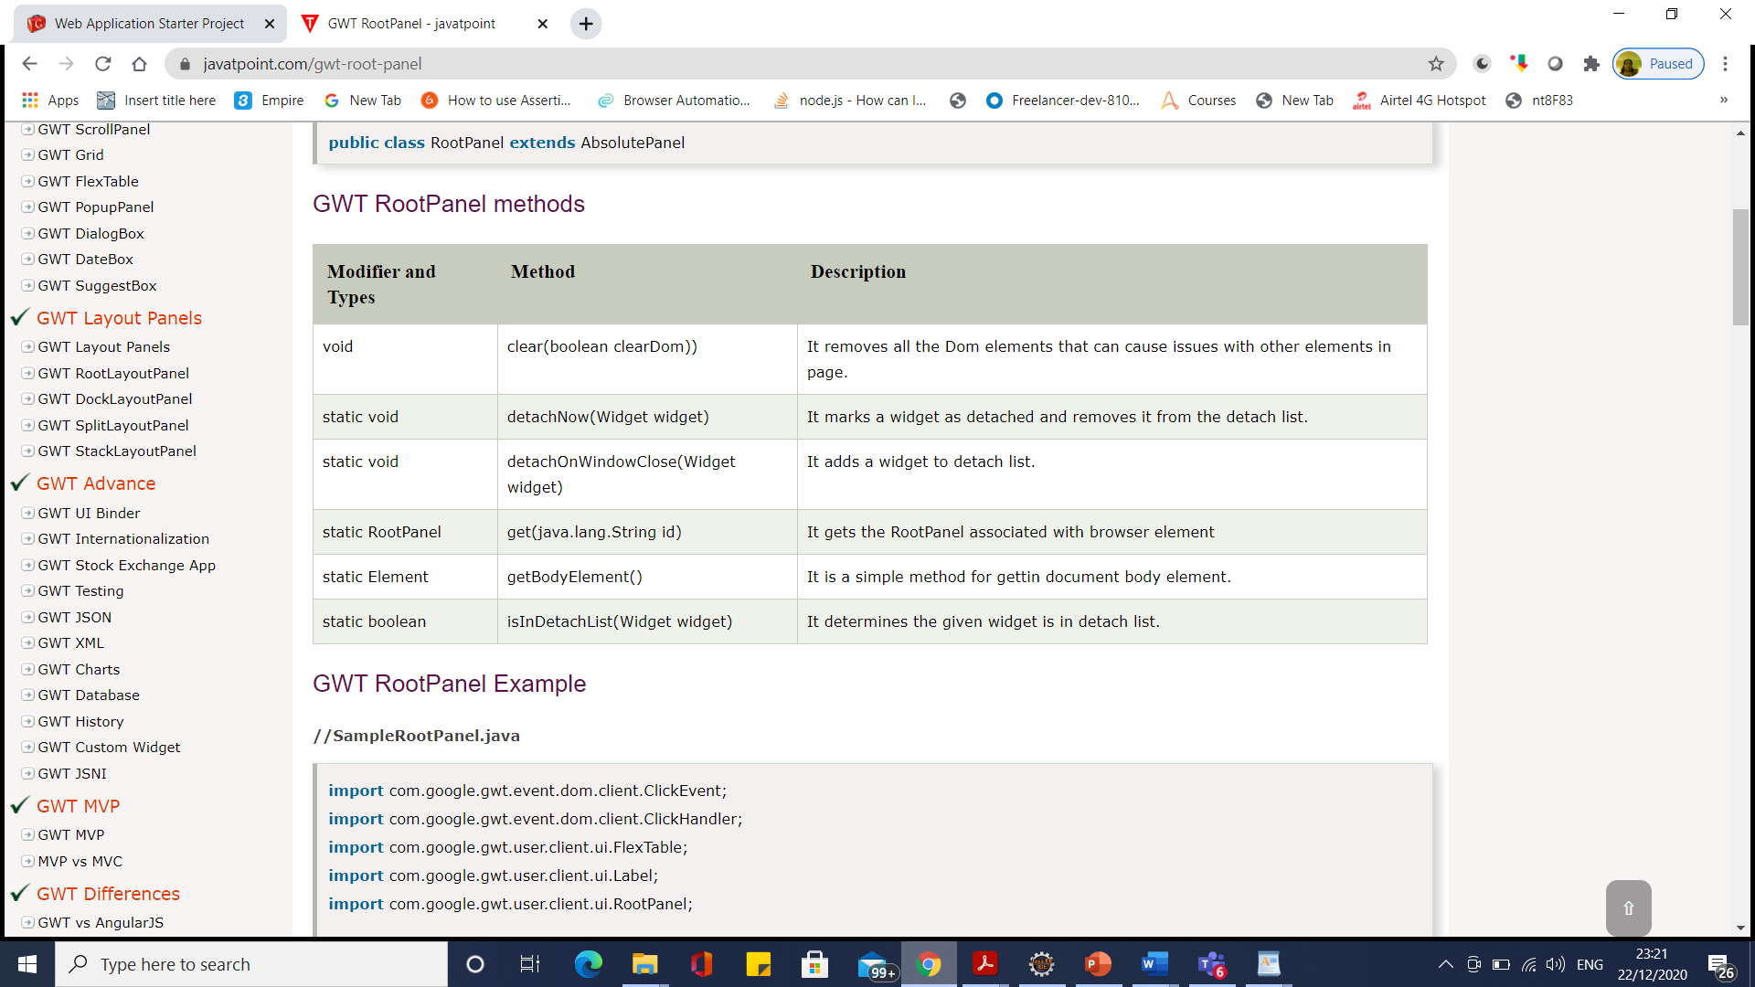
GWT Root Panel

Slide 57
GWT Flow Panel
GWT FlowPanel
GWT FlowPanel is a simplest panel as it changes the format of child widgets using default HTML layout.
In Flow Panel, no modification is done as HTML element i.e. HTML div attaches itself to children directly.
GWT FlowPanel class declaration
Let's see the declaration for com.google.gwt.user.client.ui.FlowPanel
public class FlowPanel extends ComplexPanel

Slide 58
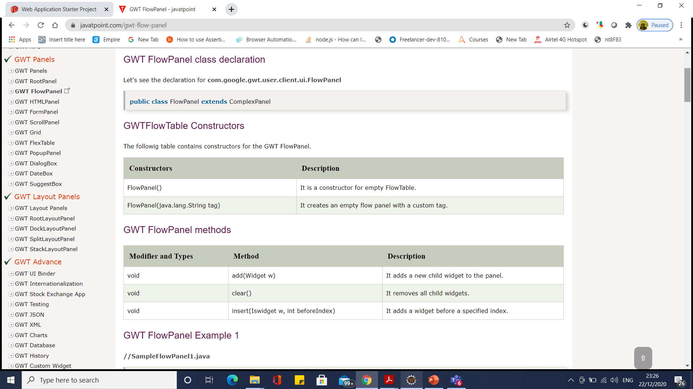
GWT Flow Panel

Slide 59
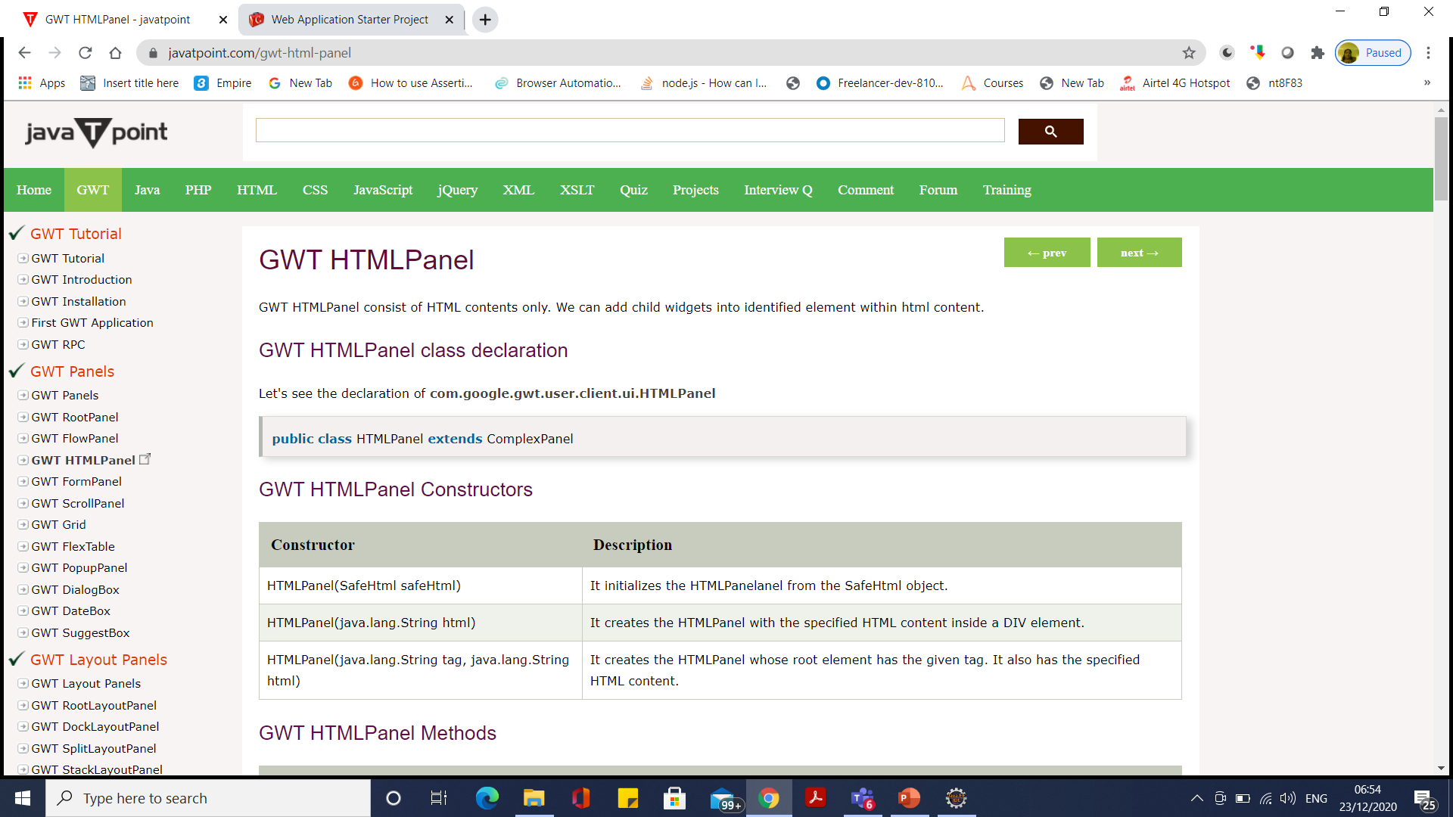
GWT HTML Panel

Slide 60
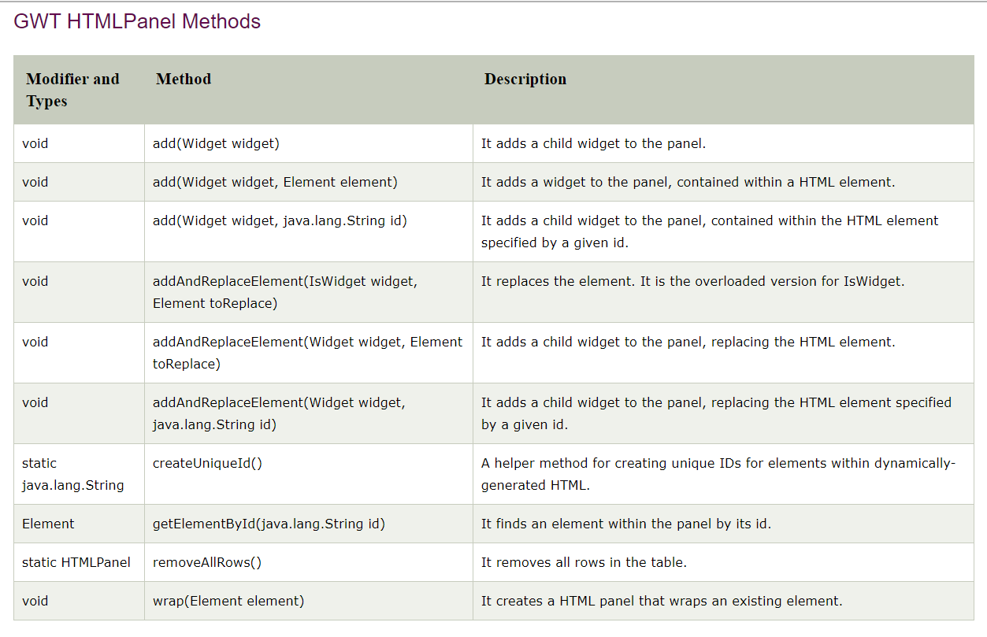
GWT HTML Panel

Slide 61
GWT Layout Panels
Layout Panel helps us to design the user interface of the panels.
This panel helps to fit all the content inside the windows.
Layout panel works in standard mode which requires HTML page in !DOCTYPE declaration.
Types of Layout Panels
GWT Root Layout Panel: It is a single panel which allows singleton implementation of layout panel. This panel attaches itself to the GWT web application.
GWT Dock Layout Panel: This widget works only in standard mode where all child widgets are at edges. The last widget occupies the center space.
GWT Split Layout Panel: This panel extends Dock Layout Panel. Its child widgets size are always specified in absolute value.
GWT Stack Layout Panel: In this layout panel, only one widget displayed at a time. We can view remaining widgets by clicking on their header. All widget that are not open is placed at bottom of the panel.

Slide 62
GWT DockLayoutPanel
In this layout panel, all its child widgets lays at corner or edges. The last widget occupies the center space.
It works also in standard mode where HTML page is having !DOCTYPE DECLARATION.
GWT DockLayoutPanel Class Declaration
Let's see the declaration of com.google.gwt.user.client.ui.DockLayoutPanel
public class DockLayoutPanel extends ComplexPanel

Slide 63
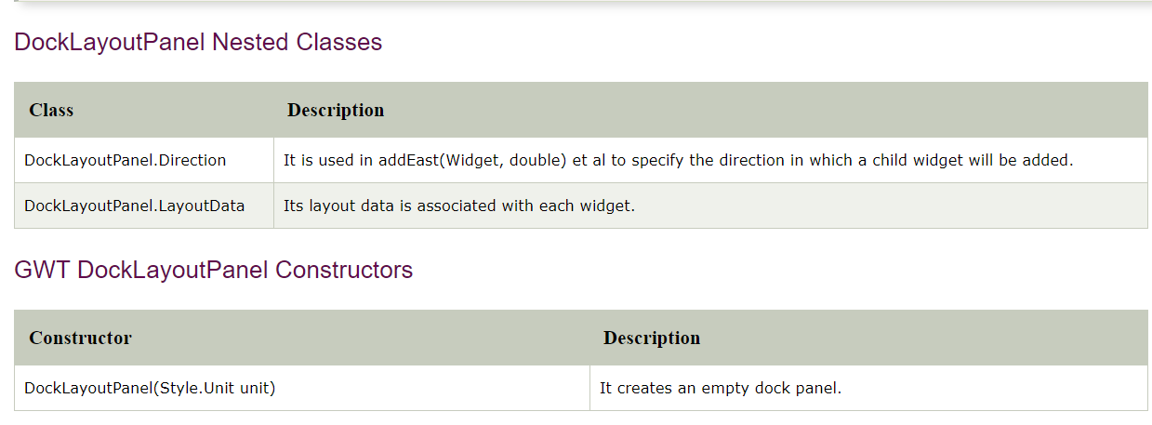
GWT DockLayoutPanel

Slide 64
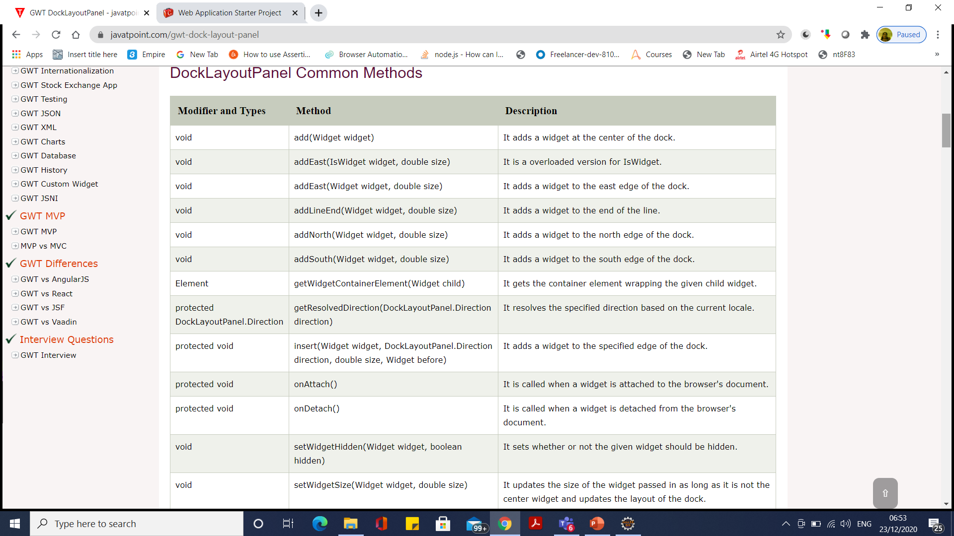
GWT DockLayoutPanel

Slide 65
GWT Widget

Slide 66
GWT Widget

Slide 67
GWT UI Binder
GWT UI Binder is used to define the user interface in a declarative way i.e. it separates the programming logic from the UI of the web application build using GWT (Google Web Toolkit).
GWT UI Binder is a framework that allows user to build GWT application as HTML pages. HTML is the best way to design a UI.
Since GWT is based on Java, if the developer has the familiarity with XHTML, HTML, XML and CSS then UI can be easily designed in GWT. It is similar to what is JSP to Servlets.

Slide 68
Roadmap of UI Binder
Step1: Create UI Declaration in XML File
Step 2: Use ui:field for Later Binding
Step 3: Create Java counterpart of UI XML
Step 4: Bind Java UI fields with UiField annotation
Step 5: Bind Java UI with UI XML with UiTemplate annotation
Step 6: Create CSS File
Step 7: Create Java based Resource file for CSS File
Step 8: Attach CSS resource in Java UI Code file.

Slide 69
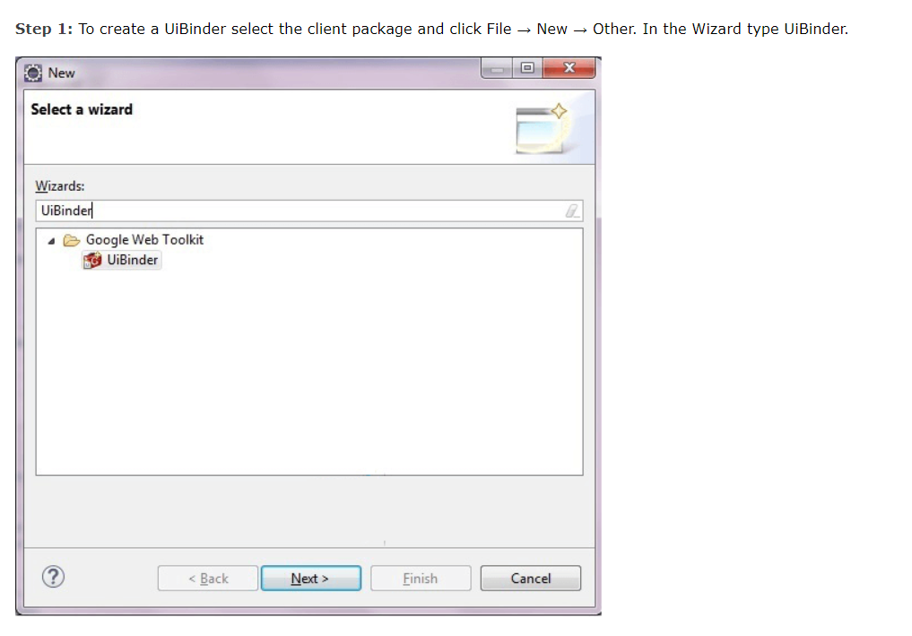
Roadmap of UI Binder

Slide 70
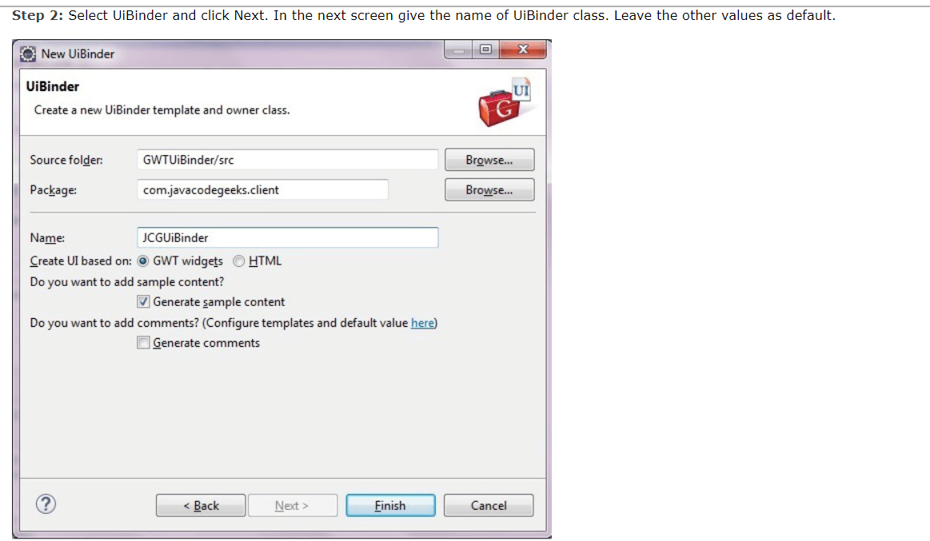
Roadmap of UI Binder

Slide 71
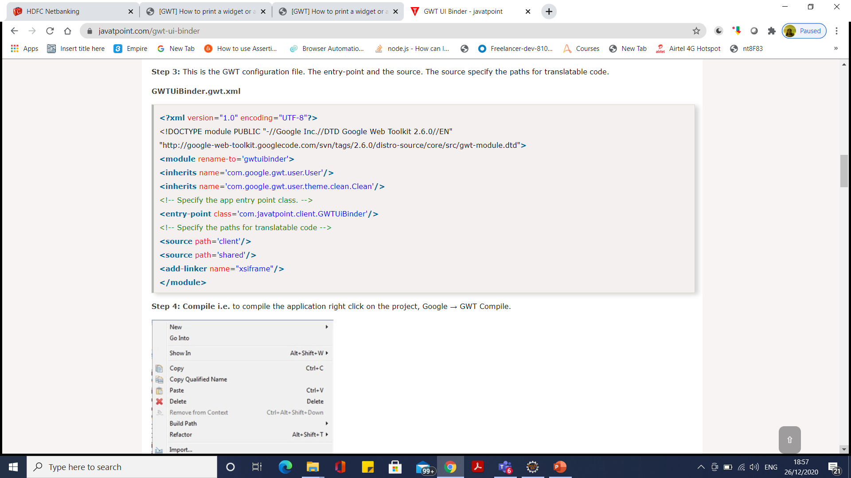
Roadmap of UI Binder

Slide 72
Building and running an example application
1. Download GWT SDK.zip
2. It has WebAppCreator
3. webAppCreator -out G:/MyWebApp com.mycompany.mywebapp.MyWebApp
For Maven
/webAppCreator -maven -out MyWebApp com.mycompany.mywebapp.MyWebApp

Slide 73
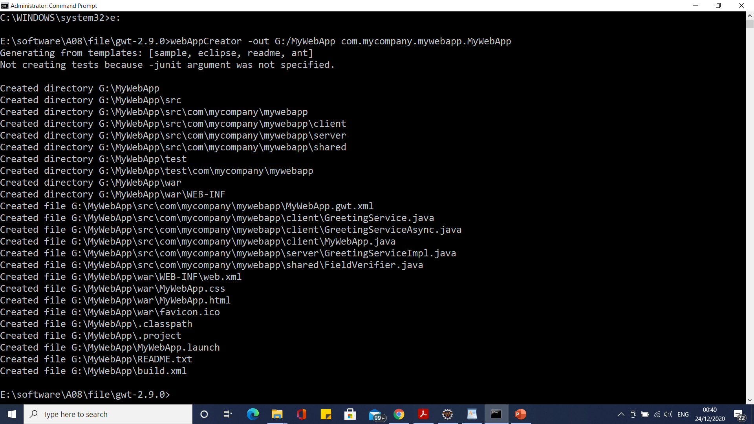
Building and running an example application

Slide 74
Building and running an example application
webAppCreator -out g:\StockWatcher com.google.gwt.sample.stockwatcher.StockWatcher
Import as as existing project to eclipse

Slide 75
Build Ant Application using Eclipse
Running the development mode code server (from Eclipse)
In the Package Explorer view, select the StockWatcher project.
In the toolbar, click the Run button (Run as Web Application). Note: When using a newer version of the chrome browser use ‘Run as Web Application (GWT Super Dev Mode)’ instead. The ‘Google Web Toolkit Developer Plugin’ needed for the default run mode doesn’t work anymore with newer browsers.
When the development mode tab opens, right-click on the URL to copy it.

Slide 76
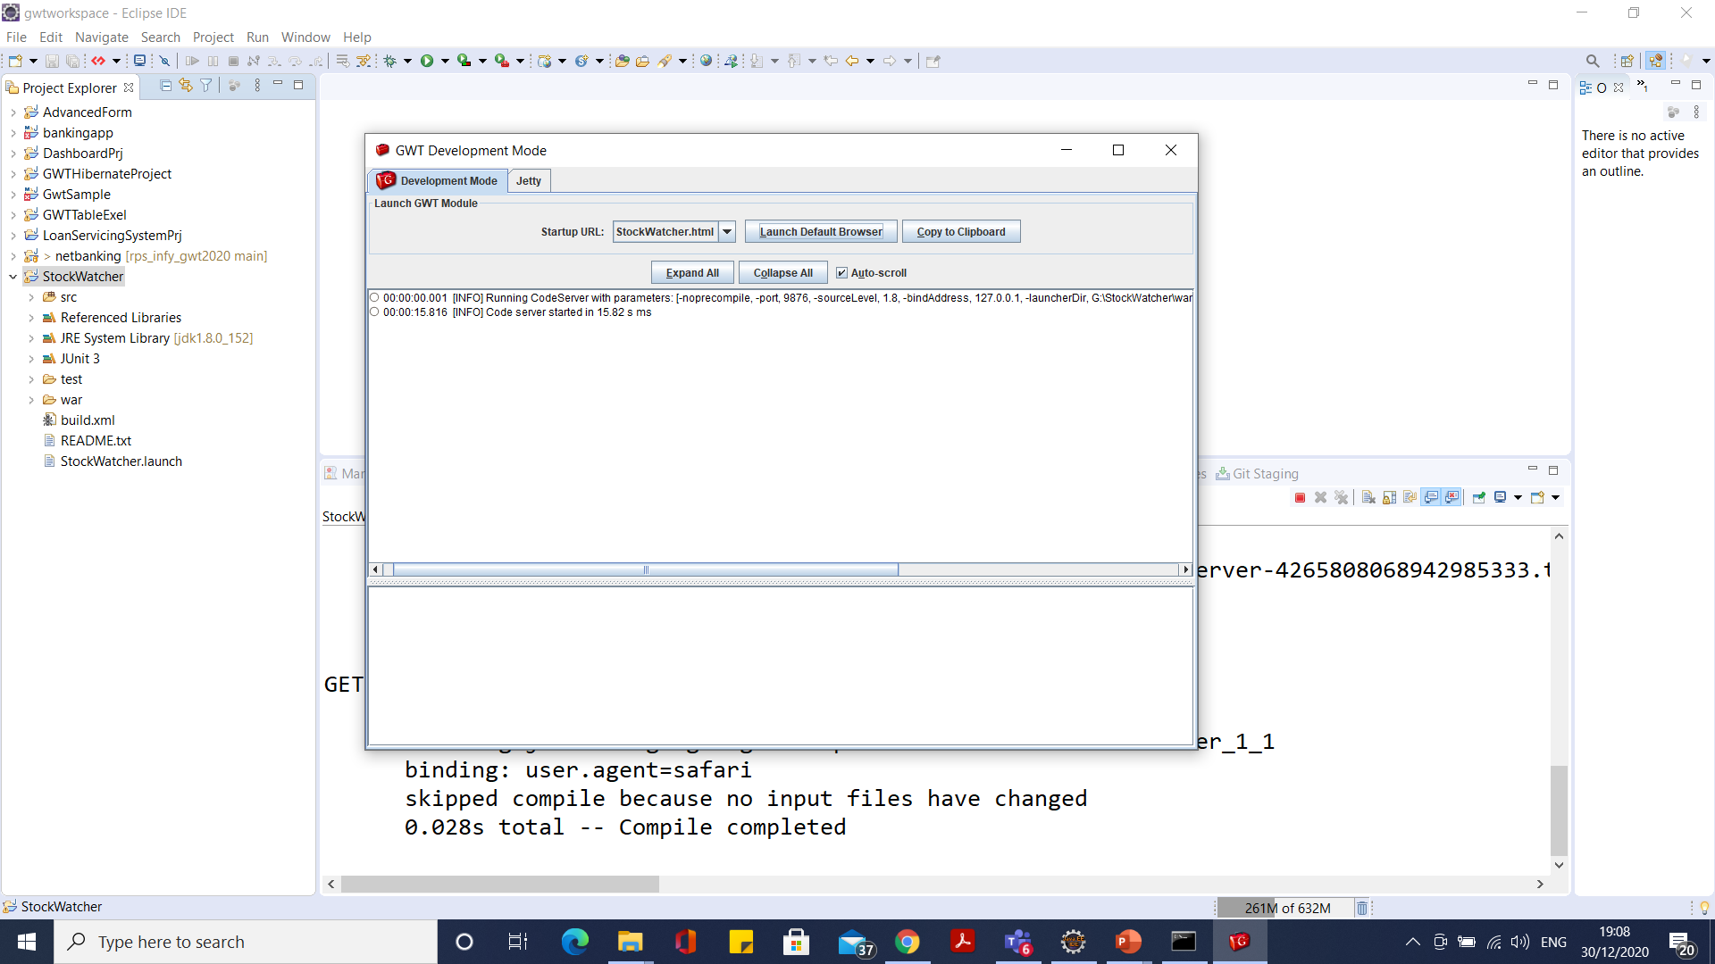
Build Ant Application using Eclipse

Slide 77
Running the development mode code server (not from Eclipse)
Set ANT_HOME
set ant in env path
Go to project folder and run the following
ant devmode

Slide 78
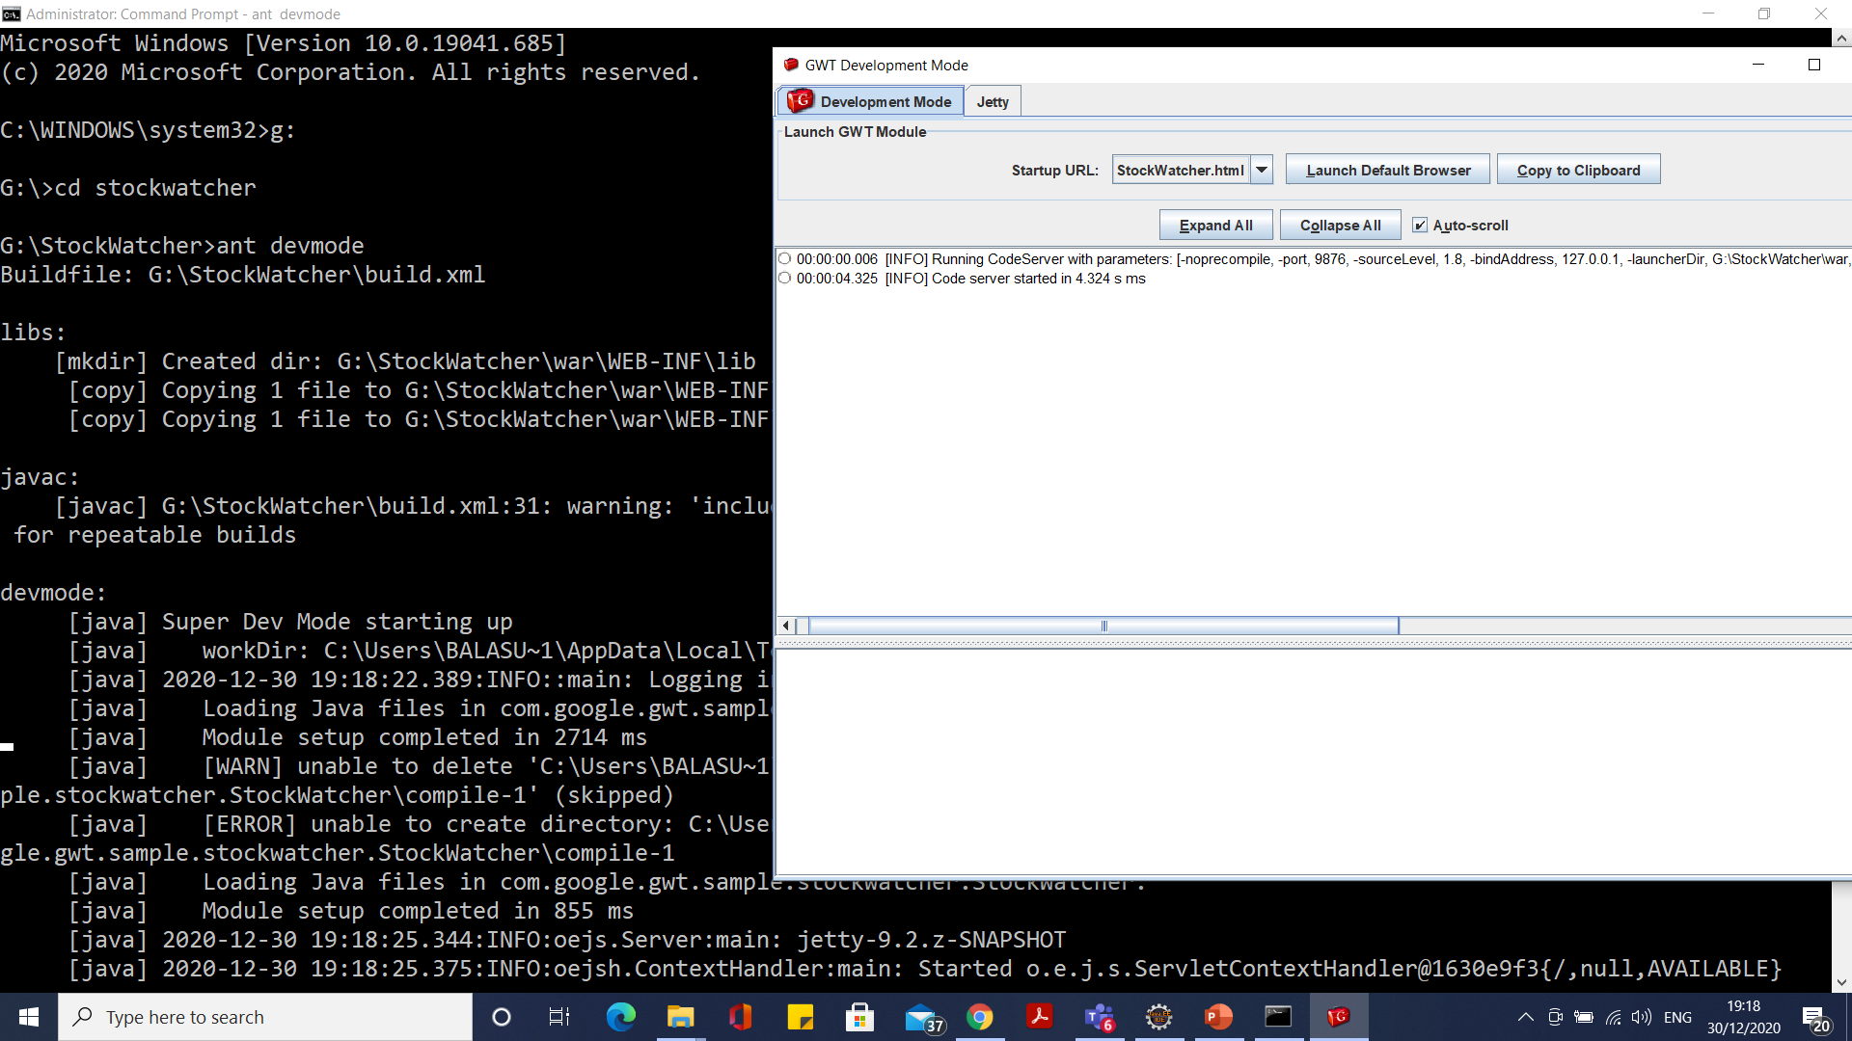
Running the development mode code server (not from Eclipse)
ant devmode

Slide 79
GWT in production mode
Solution from @Marcel Stör and @adhg is right way, if you are not as stupid as me and didn't convert your Eclipse GWT project into Maven project and thus completely destroy any automation.
So, if you have project, that working fine in dev mode, running from Eclipse, but your war directory is empty, the following is for you: it's pretty simple to make WAR manually.
I assume, that your project is calling "MyProj"
Right mouse click on your project in Package Explorer and choose GWT -> Compile.
Start you favorite file manager and create some temp directory (anywhere on your drive) to store your deployment files, for ex, myproj_deploy.
Go to MyProj/target. You'll find directory, called something like MyProj-0.0.1-SNAPSHOT. Copy it content into myproj_deploy dir.

Slide 80
GWT in production mode
Under MyProj/target there is classes directory. Go inside and you'll find folder, called "main" and root of your WEB-INF/classes dir, so create myproj_deploy/WEB-INF/classes directory and copy content of MyProj/target/classes into it, except "main" direcrory.
Now, go to MyProj/target/main/webapp. Of course, you can recognize these files.
Here is your WEB-INF/web.xml, your host HTML, your css's, etc. Copy all into root of myproj_deploy. You are almost ready.
Go to $WORKSPACE/.metadata/.plugins/org.eclipse.wst.server.core/tmpN/wtpwebapps/MyProj/WEB-INF/ and copy lib directory into myproj_deploy/WEB-INF/. That is your project library dependencies, and it's easiest way to don't forget to include some library into WAR.
Pack content of myproj_deploy into WAR as shown in @adhg answer and copy this WAR onto your Tomcat webapps dir
.

Slide 81
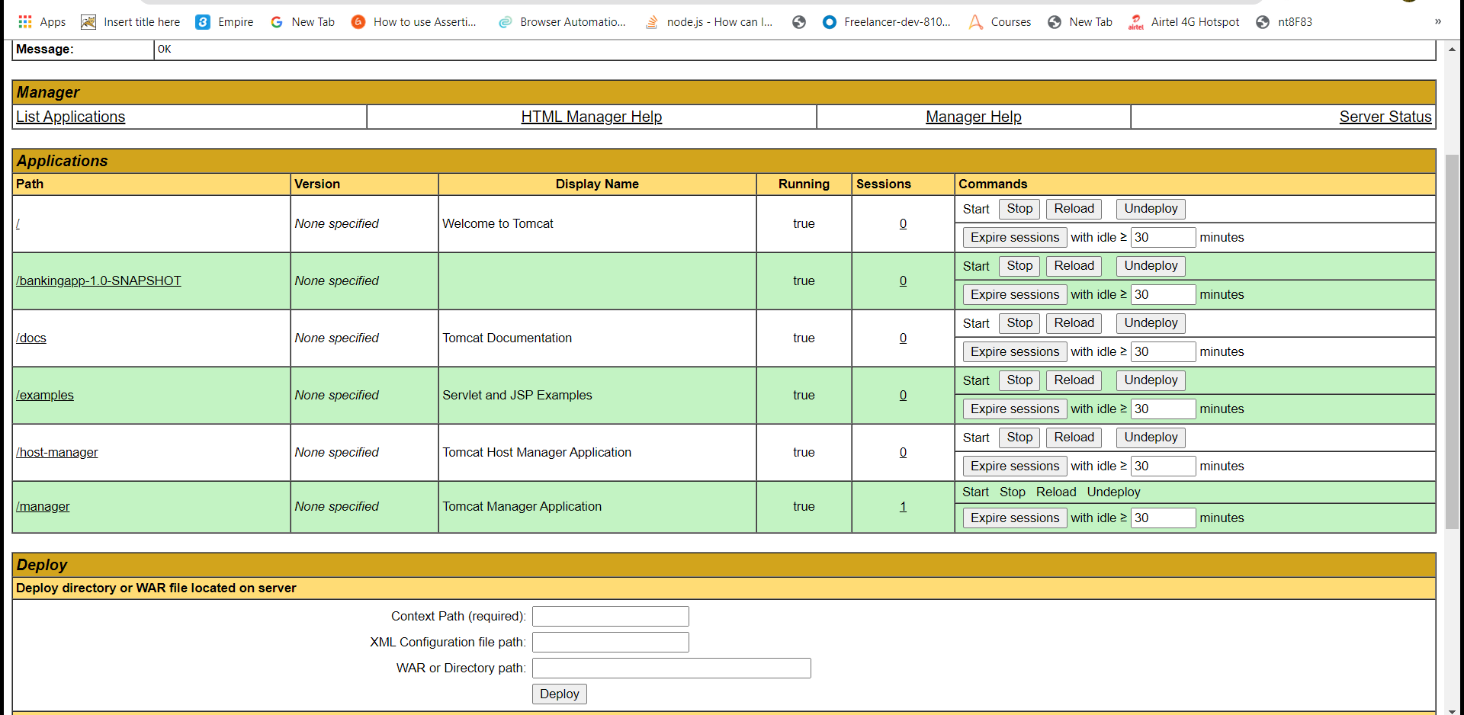
GWT in production Mode

Slide 82
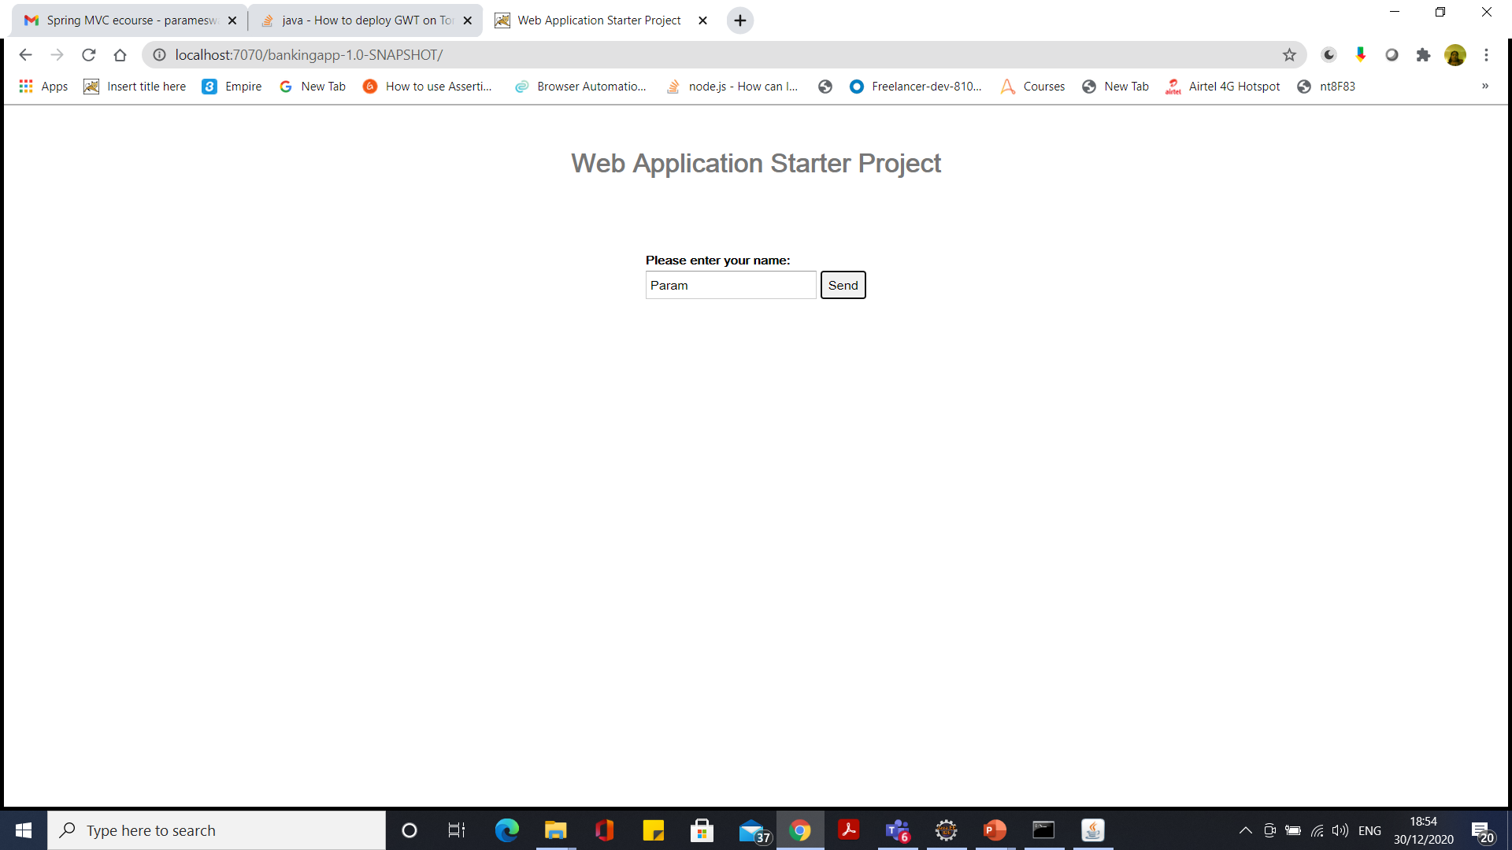
GWT in production Mode

Slide 83
Migrating from ANT to MAVEN
Create maven project use web app creator.
/webAppCreator -maven -out MyWebApp com.mycompany.mywebapp.MyWebApp
Transfer all files and folders from ant to maven
Do GWT compile

Slide 84
GWT migration from 2.6 to 2.9
GWT 2.6
Java 7 is supported and is now the default
GWT Development Mode will no longer be available for Chrome sometime in 2014, so we improved alternate ways of debugging.
There are improvements to Super Dev Mode, asserts, console logging, and error messages.
Internet Explorer cleanup: IE6/7 support is disabled by default in this release and will be gone in the next major release.
IE10 is now a separate permutation.

Slide 85
GWT migration from 2.6 to 2.9
GWT 2.6
Java 7 is supported and is now the default
GWT Development Mode will no longer be available for Chrome sometime in 2014, so we improved alternate ways of debugging.
There are improvements to Super Dev Mode, asserts, console logging, and error messages.
Internet Explorer cleanup: IE6/7 support is disabled by default in this release and will be gone in the next major release.
IE10 is now a separate permutation.
Changes

Slide 86
GWT migration from 2.6 to 2.9
GWT 2.9
Able to compile projects with jsinterop-base 1.0.0, elemental2 1.0.0, and jsinterop-annotations 2.0.0. With the exception of @JsAsync and @JsEnum, this brings GWT2 to be compatible across these tools with J2CL.
Added support for Java language levels 9, 10, and 11.
Officially, support is dropped for running the GWT compiler or server-side tooling on Java 7.
The GWT distribution is still compiled to run on Java 7 for this release, but no guarantees are made about whether or not this will work.
Future versions will compile bytecode for Java 8+. The release was tested and found to work cross platform when run with Java 8, 11, and 14.
Changes

Slide 87
Logging
Super Simple Recipe for Adding GWT Logging
<inherits name="com.google.gwt.logging.Logging"/>
# In your .java file
Logger logger = Logger.getLogger("NameOfYourLogger");
logger.log(Level.SEVERE, "this message should get logged");

Slide 88
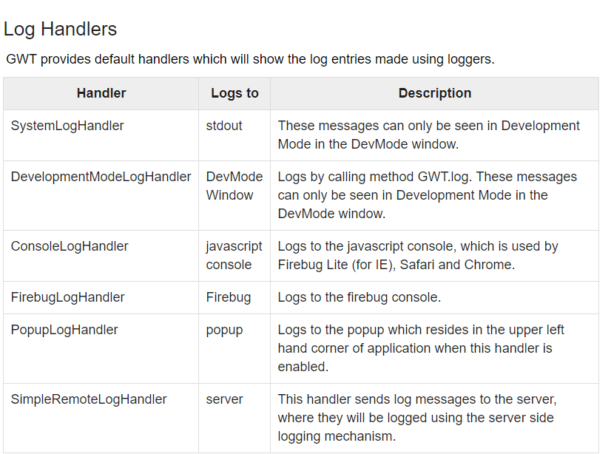
Log Handlers

Slide 89
GXT Project
mvn archetype:generate -DarchetypeGroupId=com.sencha.gxt.archetypes -DarchetypeArtifactId=gxt-basic-support-4x-archetype -DgroupId=com.infy.bankapp -DartifactId=practicelabgxt -Dmodule=Project

Slide 90
GXT Project
mvn install:install-file -DgroupId=com.sencha.gxt -DartifactId=gxt -Dpackaging=jar -Dversion=4.0.0 -Dfile=E:\software\A08\file\gxt-4.0.3-trial\gxt.jar -DgeneratePom=true

Slide 91
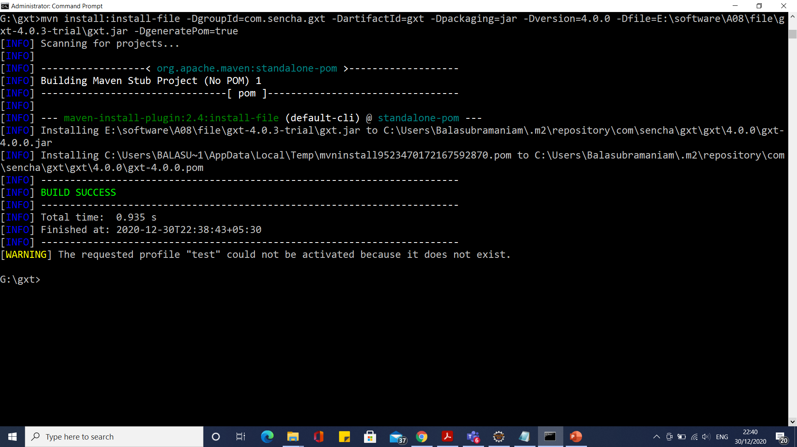
GXT Project

Slide 92
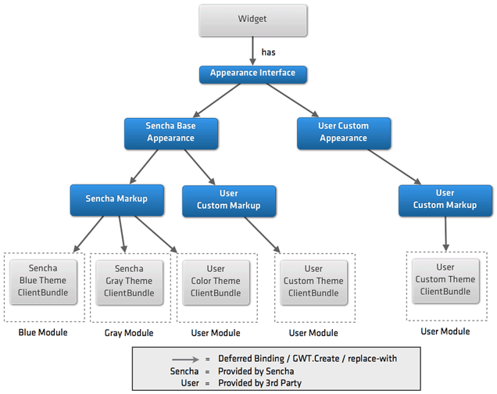
Sencha GXT

Slide 93
Junit Test
In existing project
junitCreator.cmd -eclipse ExampleProject -junit <pathToJunit>
-module org.gwtbook.ExampleProject org.gwtbook.client.ExampleTest
New Project
webAppCreator
-out HelloWorld
-junit C:\JUNIT\junit-4.10.jar
com.tutorialspoint.HelloWorld

Slide 94
Coverage Test
Using EclEmma, the Eclipse plugin for EMMA
Step 1: Install patched version of EclEmma — the Eclipse plugin
Follow instructions at http://www.eclemma.org/installation.html to install EclEmma.
Confirm that there is a “Coverage” block in the Run menu.
Step 2: Create a “Run configuration” for running the tests in development mode
Follow instructions for running tests in Eclipse
Step 3: Get initial coverage data

Slide 95
Coverage Test
From command line
Go to ant project and ensure project running
webAppCreator -junit E:\software\A08\file\junit-4.13.1.jar -out g:\infyantapp com.infy.stockwatcher.BankApp
java -cp G:\emma-2.0.5312.jar\emma-2.0.5312.jar emma instr -m overwrite -cp war/WEB-INF/classes/com/infy/stockwatcher/client
ant test.dev
java -cp G:\emma-2.0.5312.jar\emma-2.0.5312.jar emma report -r html -in coverage.em,coverage.ec

Slide 96
Spring Security
commons-logging
spring-aop
spring-asm
spring-beans
spring-context
spring-core
spring-expression
spring-security-config
spring-security-core
spring-security-web
spring-web

Slide 97
Chrome Settings
chrome.exe --user-data-dir="C://Chrome dev session" --disable-web-security

Slide 98
Questions

Slide 99
Module Summary
In this module we discussed
Overview of Maven
Maven archetypes
Maven life cycle phases
The pom.xml file
Creation of Java projects using Maven
Creation of war files

